Slide 1
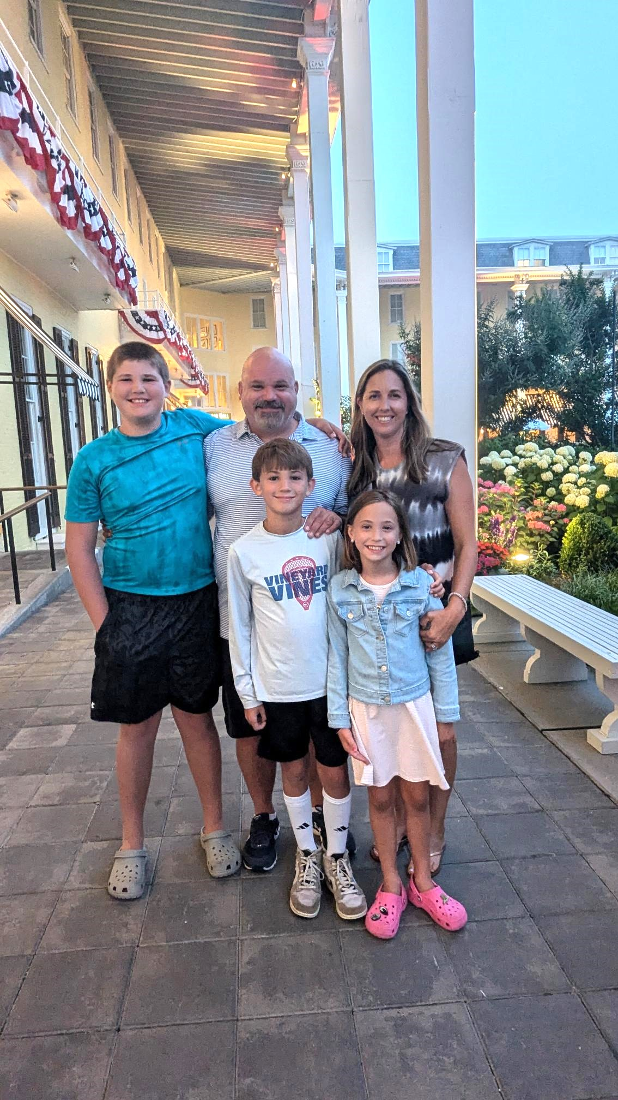
Mrs. Yar
Add your picture here!
This will be my 4th school year at Hickory Creek! I love being a HAWK! I grew up in Florida but most recently lived in New Jersey and my family and I moved down to Florida in 2021. I was an Elementary School Counselor in the Tampa area and in New Jersey. I am married and have 3 children- 7th, 6th and 3rd grade. I have 2 dogs- Copper and Leo. My family and I love to swim and go to the beach in our free time. My husband and I spend a lot of time on the soccer fields watching our kids play, which we enjoy. I LOVE being able to come to work everyday to advocate for all students and I am looking forward to a great school year!
Education
Counseling
Program
I graduated with my Bachelor of Science degree in Psychology and a Minor in Child Development from Florida State University.
I have my Master of Arts degree in School Counseling K-12 from the University of South Florida.
Add college logo here!
Mental Health/Social Skills- Groups and Individual
Classroom Guidance Lessons
Character Counts Contact
504 Plan Coordinator
MTSS Team Member
Threat Assessment Vice Chair
Bullying Reports
Testing Coordinator- FAST/WIDA-ESOL testing
ESOL Coordinator
Community Outreach/ Parent Resource
Attendance Concerns/Celebrations
Hickory’s Heart Contact
Contact me:
The best way to contact me is via email: Lara.Yar@stjohns.k12.fl.us or by phone: 904-547-7468
Please expect a response within 48 hours.

